Slide 1
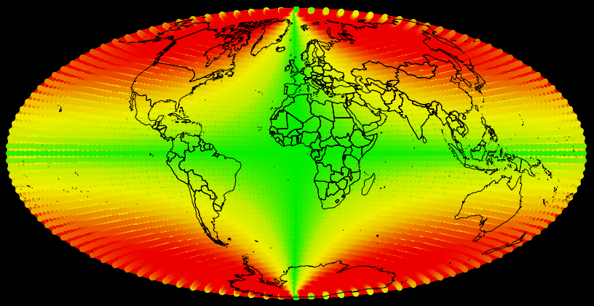
Dr. Jim Graham and Chris Muhl
Humboldt State University, 2014

Slide 2
The Need
Error varies greatly between projections and their settings
Computing error in projections can be time-consuming
Projections can be difficult for students to appreciate

Slide 3
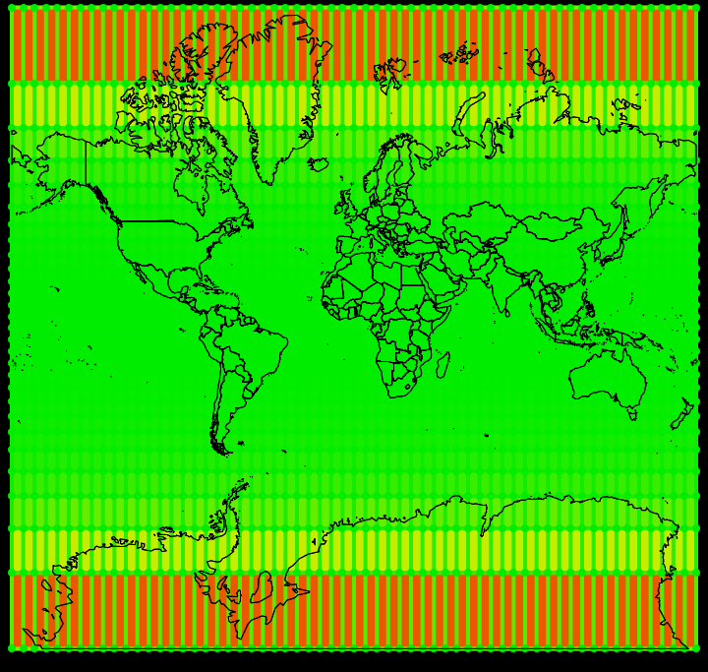
Projections greatly distort area, distance, and/or shape (form)
Mercator
0 to 50 area and distance distortion

Slide 4
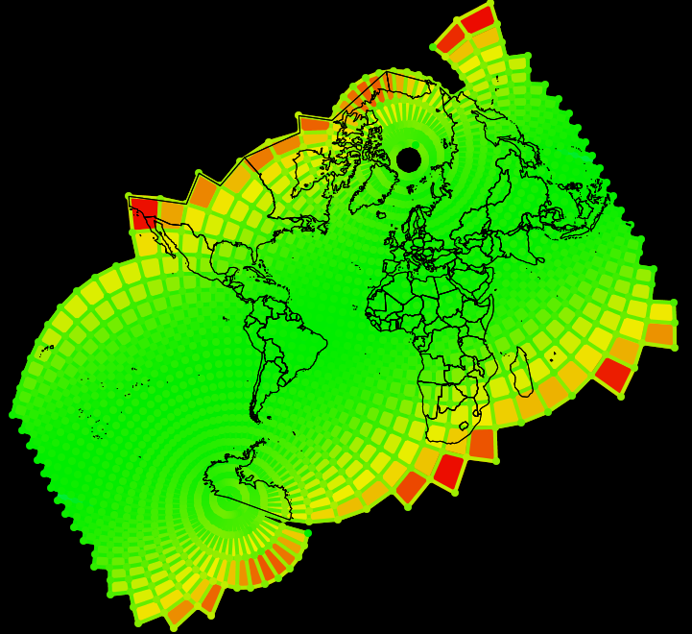
The nature of distortion can be difficult to describe in text
Oblique Mercator
0 to 10 area and distance distortion

Slide 5

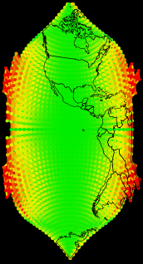
Clipping Bounds are required
Clipping bounds are also needed
Cassini
Soldner
Projection
Limited to 0 to 2x distance distortion
Default
Notes:
Cassini Soldner, default settings

Slide 6
Previously, to Compute Area Distortion
Create “Fishnet” of polygons
Project to equal-area projection
Compute “Exact” areas
Project to desired projection
Compute projected areas
Divide the exact by projected area values
  <1: area was made much smaller than expected
  >1: area was made larger than expected

Slide 7
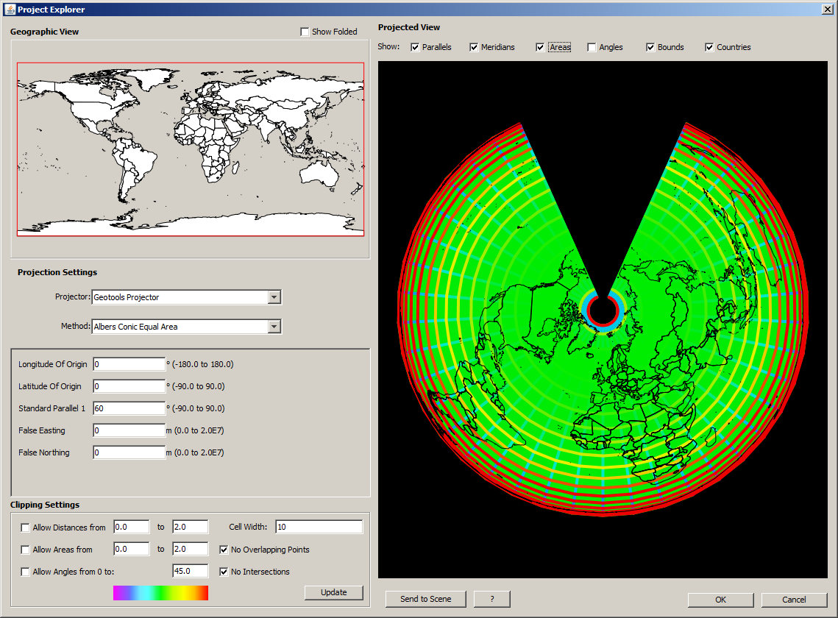
Today:
Selection projection
Enter desired settings
Press “Update”
“OK” to add layers

Slide 9
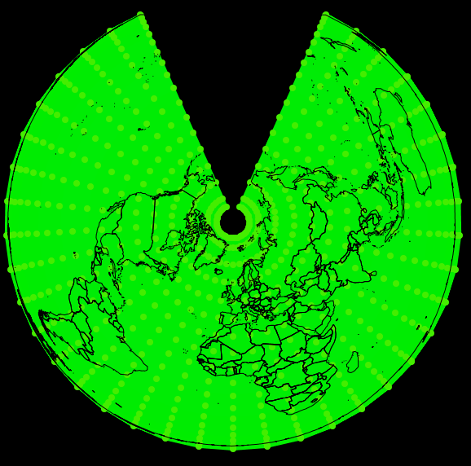
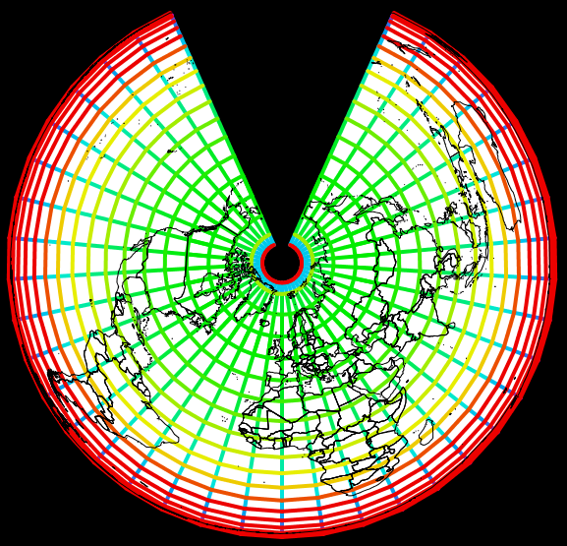
Albers Equal Area Conic
Preserves Area and Form
Distorts Distance

Slide 10
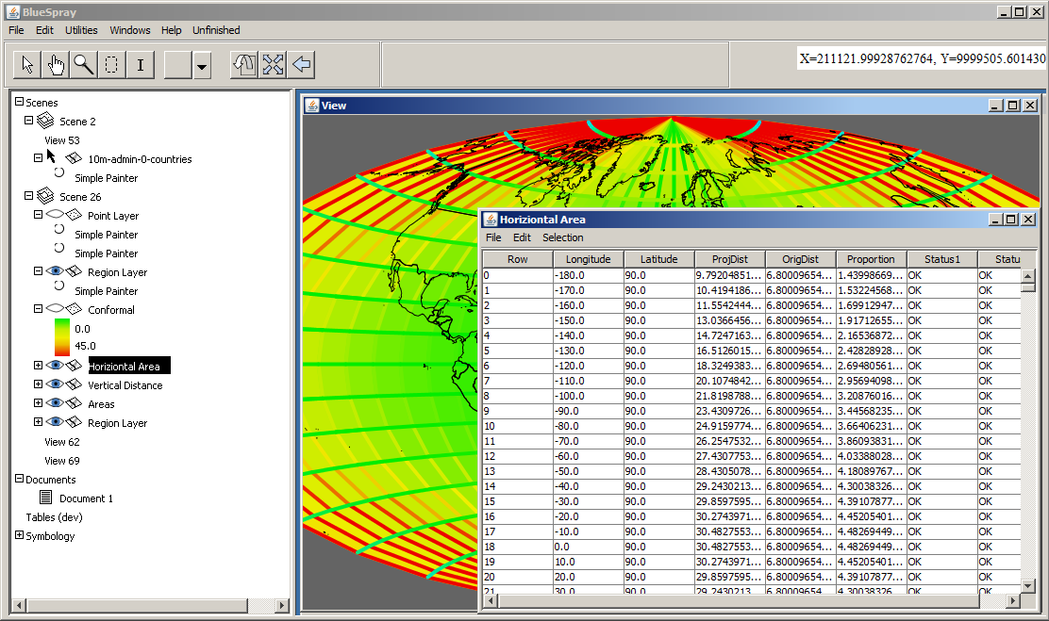

Slide 11
The Approach
BlueSpray
  Created by SchoonerTurtles, Inc.
  Provided free under a beta testing agreement
GDAL, GeoTools
  Open source projection engines
Also:
  Java from Oracle
  Java Topology Suite
  NetBeans

Slide 12
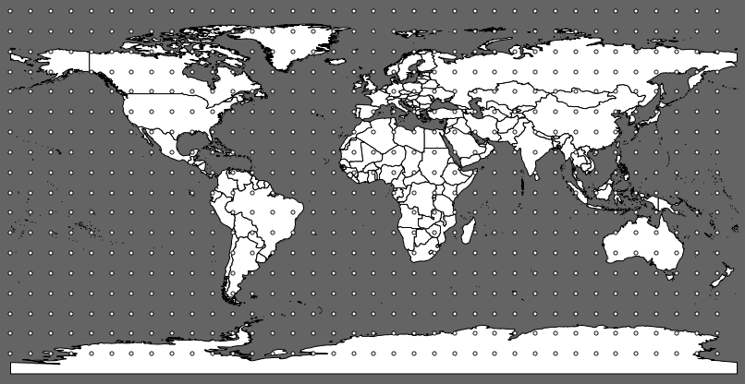
Create grid of points along lines of latitude and longitude (parallels and meridians)

Slide 13
Compute:
  Great circle area
  Great circle distances (along meridians and parallels)
  Angles are at intersections are 90 degrees except for the poles

Slide 14
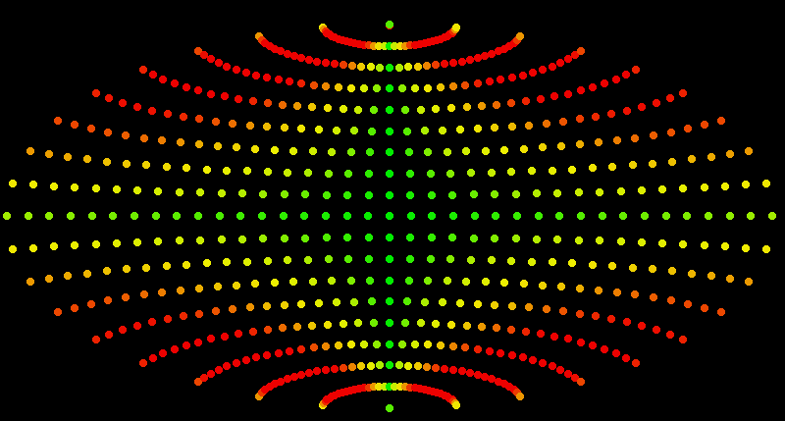
Project the grid of points to desired projection

Slide 15
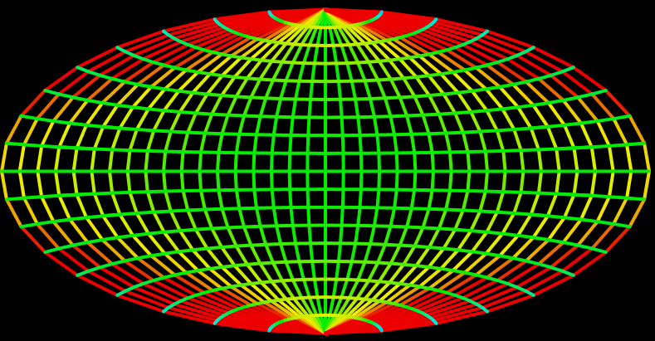
Compute area of “cells” between points
Divide by expected area
Compute the length of each line segment
Divide by expected length

Slide 16
Compute the average change in angle at each point
  Sum the angle between all the line segments at each point
  Divide by the number of angles to find the average angle
  Divide by expected value of 90 dgrees

Slide 17
Finding the bounds
Start at the center (0,0)
Moving left and right two cells then up and down one cell:
  Add cells that are within the specified tolerances
  Check for overlapping points
  Check for intersecting lines

Slide 18
Adding “Cells”
Assumed the first four cells were within tolerances

Slide 19
Adding “Cells”
1
3
2
4
Add cells to left and right that are within tolerance

Slide 20
Adding “Cells”
5
1
3
7
6
2
4
8
Add additional cells to the left and right since the world is twice as wide as it is call (with Geographic data)

Slide 21
Adding “Cells”
11
10
9
12
13
14
5
1
3
7
6
2
4
8
17
16
15
18
19
20
Add cells along the top and bottom.
Keep repeating the cycle until no more cells are added

Slide 22
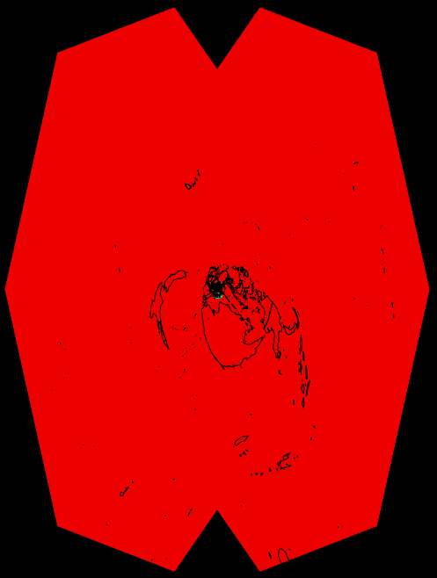
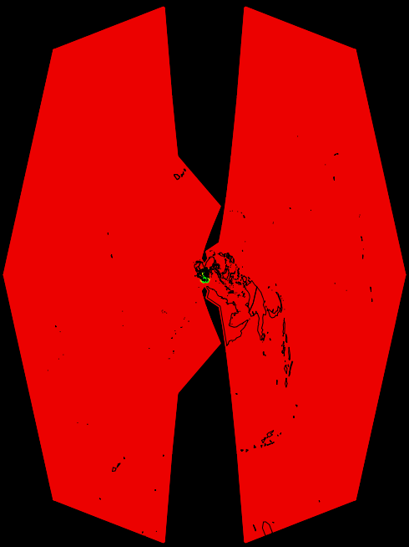
Disallow Intersections and Overlaps

Slide 23
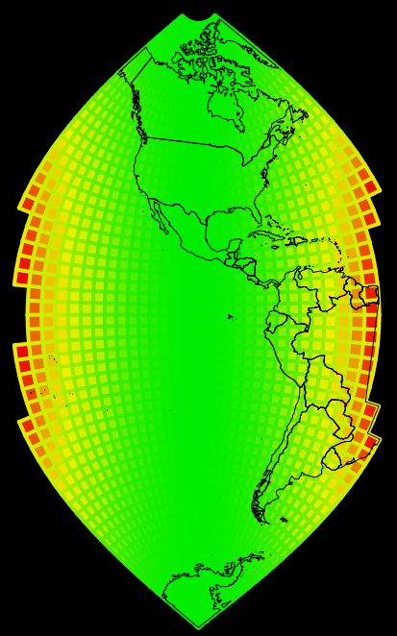
Limit Distortion
0 to 2x on area and distance

Slide 24
Details
Accessing vector data from an applet
  Used BlueSprays “stx” format
Java Topology Suite is very picky
Projected Systems can extend beyond +-180 to +-90 degrees
  Used a 360*3, 180*3 sized grid for analysis

Slide 25
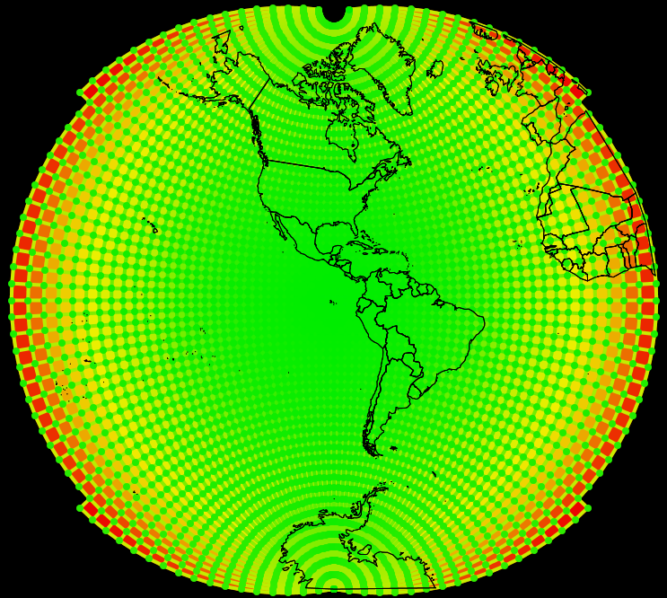
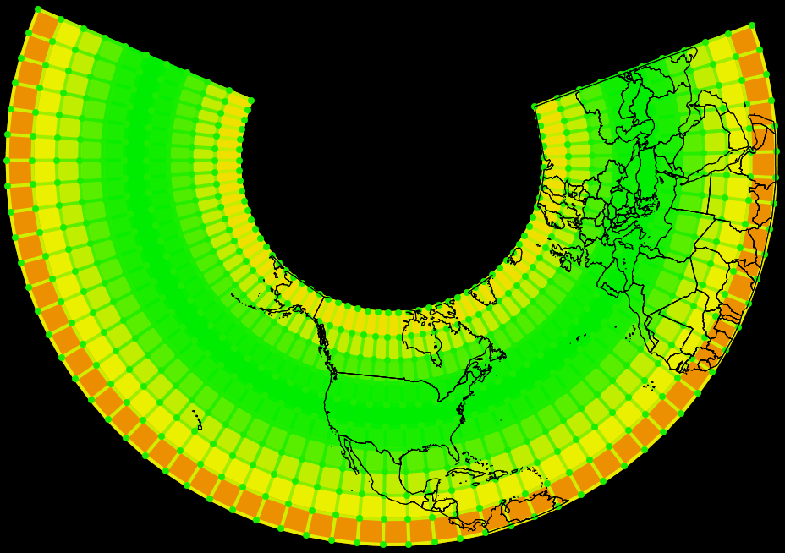
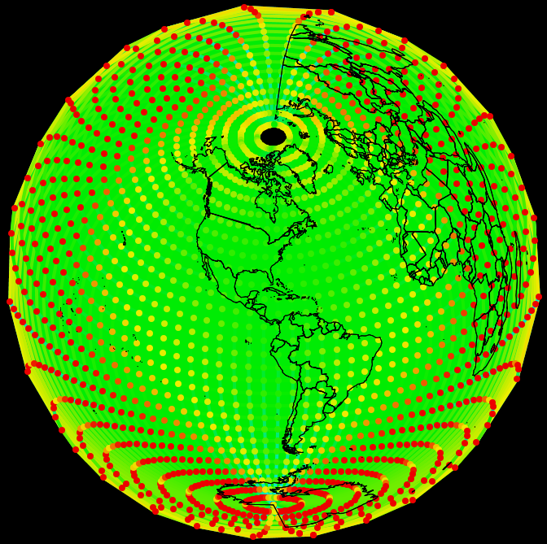
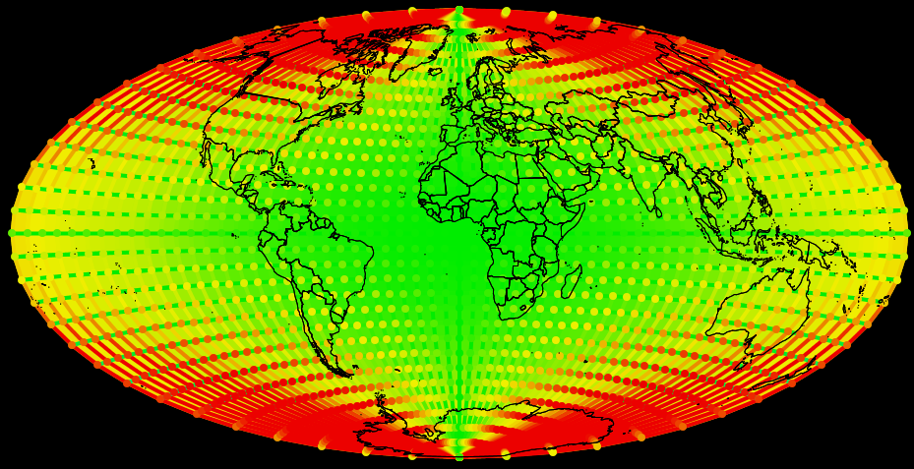
Lambert
Conformal
Conic
Oblique
Stereographic
Lambert
Azimuthal
Equal Area
Aitoff

Slide 26
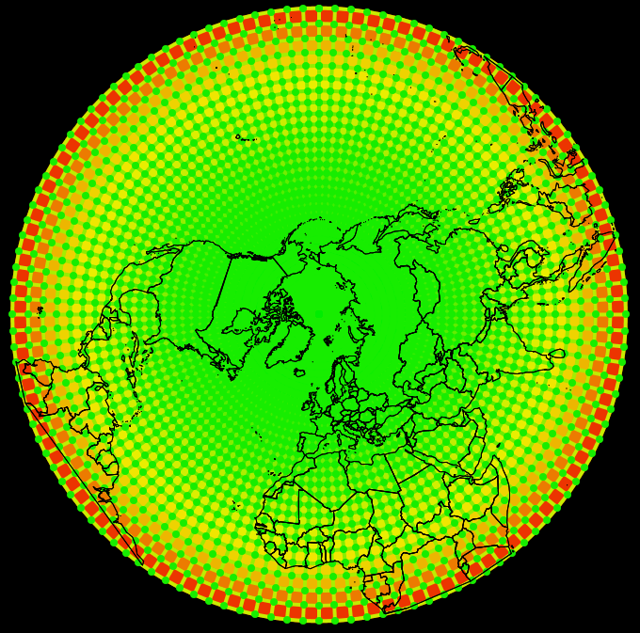
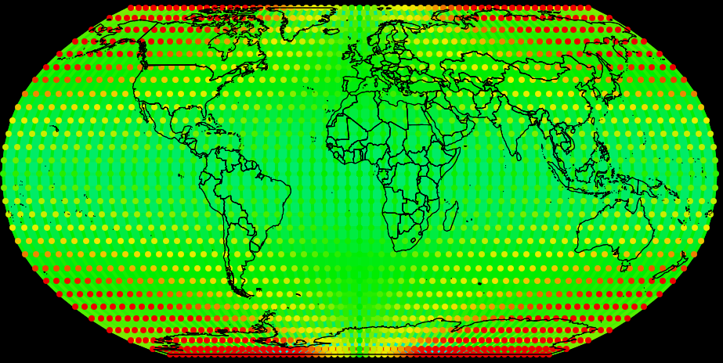
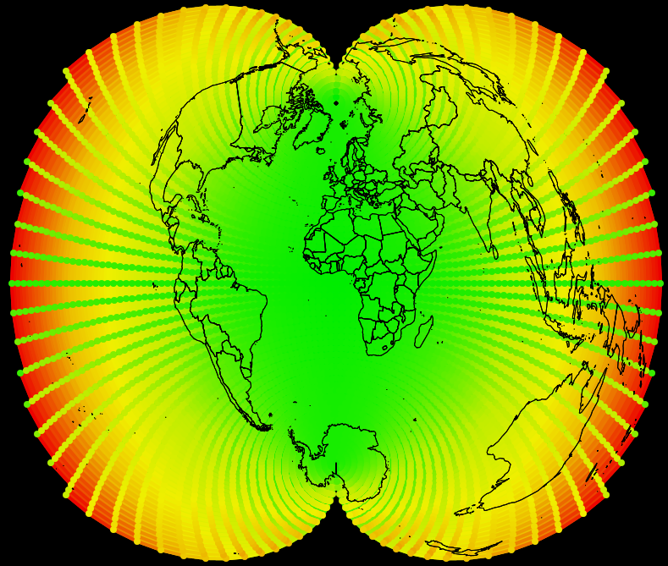
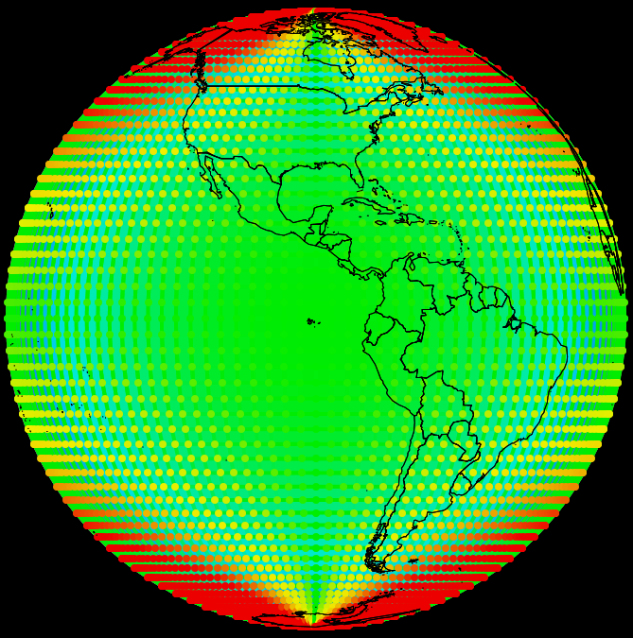
Robinson
Polar
Stereographic
Polyconic
Orthographic

Slide 27
Available At:
Applet:
  HSU Geospatial Web Site
  www.humboldt.edu/gsp -> Links
BlueSpray:
  SchoonerTurtles web site:
  www.schoonerturtles.com

Slide 28
Future Steps
Add the ability to project from any layer
  Not just the globe
Finish projection engine within BlueSpray
  Uses the Projection Explorer to set the bounds

Slide 29
Acknowledgments
Jake Nelson, Dr. Bernhard Jenny at Oregon State University
Nick Ramirez at Humboldt State University
Greg Newman at Colorado State University
All the folks that support open source GIS software: GDAL, GeoTools, Proj4, JTS, NetBeans, etc.

Slide 30
